Slide 1

PROJECT PRESENTATION
ON
POWERLINE COMMUNICATIONS
In partial fulfillment of the requirements for the award of the degree of bachelor of engineering in electronics and communications engineering
Under the guidance of
Prof.Dr.Hossam El-Deen Mustafa
Alexandria University
Faculty of Engineering
Department of Communications & Electronics Engineering

Slide 2
ABSTRACT
In the latest generation of home automation systems, appliances can exchange information by transmitting data over the domestic mains wiring. As a result there is no need to install extra control cables and appliances can be connected to the network simply by plugging them into the nearest wall socket.
Microcontroller can easily be used in conjunction with X- 10 technology to create home automation applications.A PIC uC or an AVR uC can be selected for this application because of its versatility as a general purpose microcontroller, its FLASH program memory(for ease of development), data EEPROM, and ample I/O ports.
Several ready to use powerline modem chips can also be used to implement a full power line communications systems like the TDA5051AT which will be discussed in a later section or the MAX20340 IC used in DC power line communications

Slide 3
POWER LINE COMMUNCIATIONS
Power Line Communication (PLC) is a data transmission technology using existing cables such as power lines, coaxial cables, twisted pair cables, etc.
By using existing cables as a transmission medium, it is possible to quickly build a network at a low cost.
In the case of using power lines, power and data transmission can be done with a single cable, which can reduce the types of cables in a network.
PLC is a technology which has been in use since years but came now in more demand after the launch of new communication technologies which are being supported by PLC i.e. PLC would be a reliable communication medium for applications like Internet-of-things (IoT)

Slide 4
TYPES OF POWERLINE COMMUNICATION
Basically, there are four types of PLC:
In-house networking: High-speed data transmission can be provided for home networking using the In-House mains power wiring.
Broadband over Power Line: Broadband internet access can be offered through the outdoor mains power wiring.
Narrowband in-house applications: Low bit rate data services like home automation and intercoms can be controlled and used for communication through the In-house power mains which is the main focus of our project
Narrowband outdoor applications: Narrowband outdoor applications can be used for automatic meter reading and remote surveillance or control.

Slide 5
HOW DOES PLC WORK
The basic principle of Power Line Communication is the following.
When transmitting and receiving data between two devices, the data is modulated on the transmitter, and the modulated signal is superimposed on the AC or DC power supply voltage.
In the receiver, the data is extracted by separating the power supply voltage and the modulated signal with a filter and demodulating the modulated signal.
PLC can be used on AC power lines, but keep in mind that it can also be used on DC power lines. For example, it can be used for storage batteries, lighting, EV charging, etc.

Slide 6
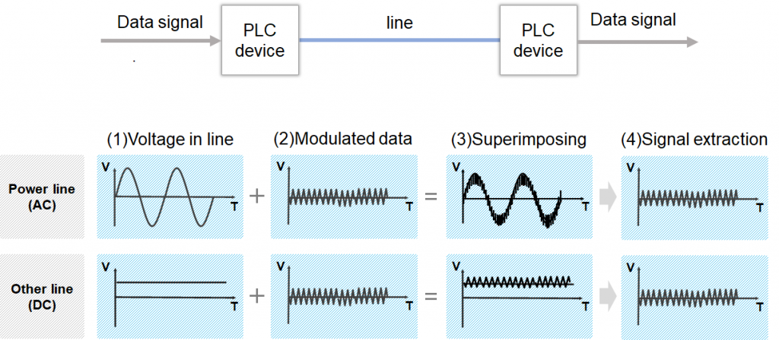
Illustration of a basic PLC system

Slide 7
ADVANTAGES AND DISADVANTAGES OF PLC
You can compare PLC to Wi-Fi and Ethernet from several viewpoints.
PLC has advantages and disadvantages compared to them, and it enables you to build a network with a moderate performance at a low cost.
note that the advantages and disadvantages of PLC are not fixed and depend on what you are comparing.
An advantage compared to Wi-Fi can be a disadvantage compared to Ethernet (and vice versa, of course).

Slide 8
Advantages :
Vs. Wi-Fi
Higher security – There is little risk of data eavesdropping and falsification.
Stability – The change of transmission characteristics due to the surrounding environment is small, so a constant performance is maintained.
Complementary to Wireless – Data transmission using existing cables installed there is possible even in areas where radio waves are hard to reach (e.g., underground, elevator, steel ship, etc.).
Vs. Ethernet
Lower installation cost – Installing new cables and HUBs for relaying is not needed.

Slide 9
Disadvantages
Vs. Wi-Fi
Lower speed – Maximum speed in the standard is lower than Wi-Fi (9.6 Gbps).
Mobility – The place of the communication equipment is fixed.
Vs. Ethernet
Lower speed – Maximum speed in the standard is lower than Ethernet (10 Gbps).
Unstable environment – The influence of noise from connected devices exists in the case of using power lines.

Slide 10
APPLICATIONS FOR PLC SYSTEMS
PLC technology is widely used in the following systems to empower Smart Building, Smart Factory, Smart Grid, and Smart City, etc., as a solution to reduce network construction costs.
Advanced Metering Infrastructure (AMI) systems
Elevators
Storage batteries
Smart street lights
Lighting control systems
Security camera systems

Slide 11
CHANNEL CHARACTERISTICS
Multipath effect caused by impedance mismatches, causing :
intersymbol interference .
frequency selectivity.
Attenuation, depends on :
distance between the TX and RX.
Number and position of reflection points( branches ).
Frequency dependent Signal to Noise Ratio (SNR).
Types of Noise:
Colored background, due to different low-power noise sources.
Narrowband interferences,caused by radio broadcasters.
Impulsive noise such as :-
synchronous, generated by rectifier diodes used in electrical appliances.
asynchronous, caused from switching transients (This is the most detrimental type of noise).

Slide 12
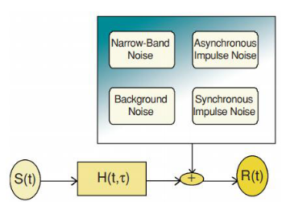
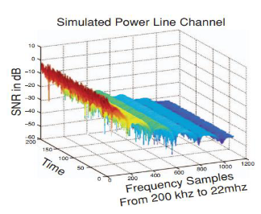
Fig . Channel model
Fig . Simulated power line channel

Slide 13
Communication Techniques
FSK, Low spectral efficiency (suitable for low data rate application such as power line protection and telemetering ).
For data rates up to 1Mbps, the CDMA technique may provide an effective solution.
The symbol duration is so small that delayed versions of one symbol - due to multi-paths - gets smeared over a large number of other symbols.
With OFDM, since the data is split among N sub-carriers, the symbol duration for each sub-carrier increases N times, moreover a cyclic prefix is applied with length longer than longest delay path. This solves the intersymbol interference.
OFDM, we can avoid transmitting at frequencies in deep fade.

Slide 14
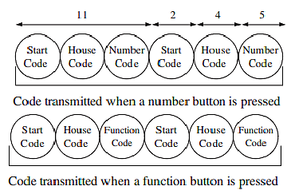
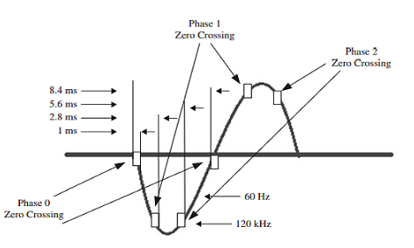
X-10 PROTOCOL
Narrowband protocol
Rate(bit/sec) = 60
Most popular
X10 limitations
The high attenuation in wires and transformer winding(especially, between different phases).
Slow Rate.

Slide 15
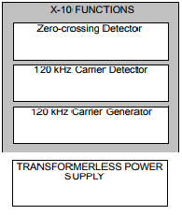
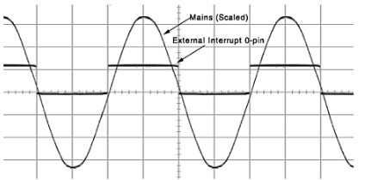
Hardware Description
Zero-crossing detector.
120 kHz carrier detector.
120 kHz signal generator.

Slide 16
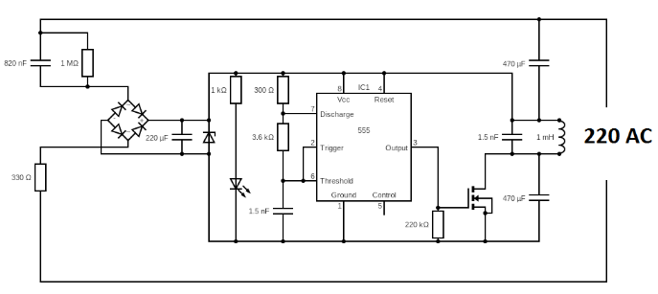
Test Circuits For PLC
Transmitter

Slide 17
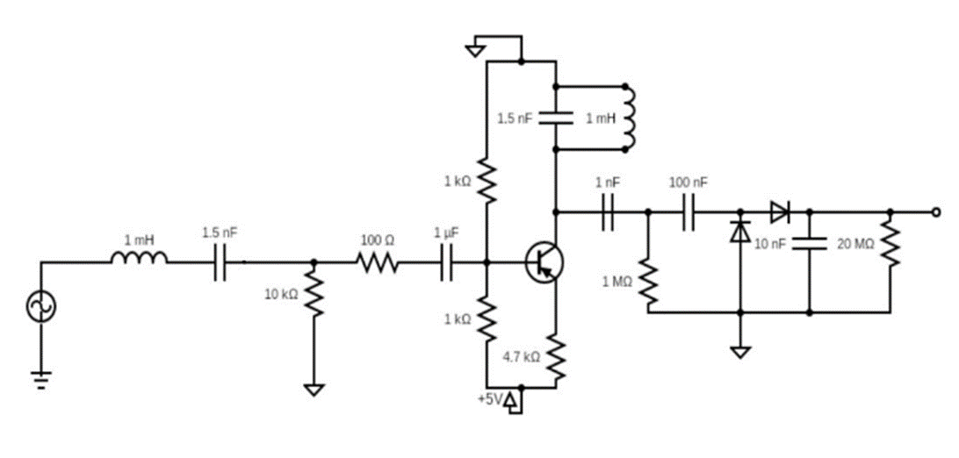
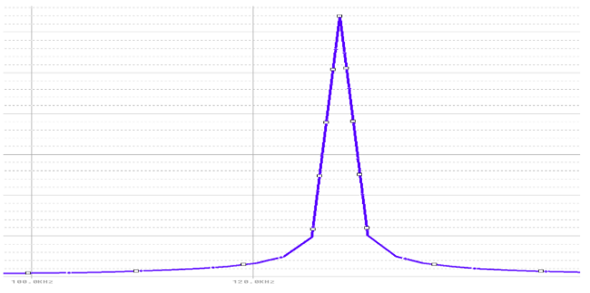

Slide 18
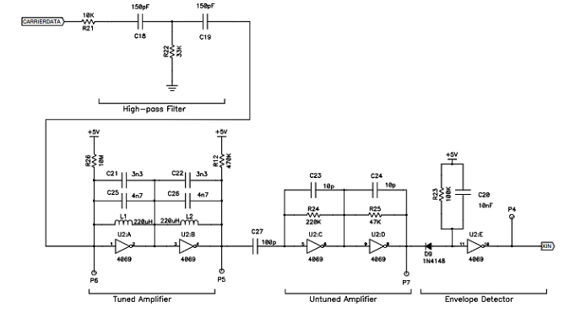
Carrier Detector

Slide 19
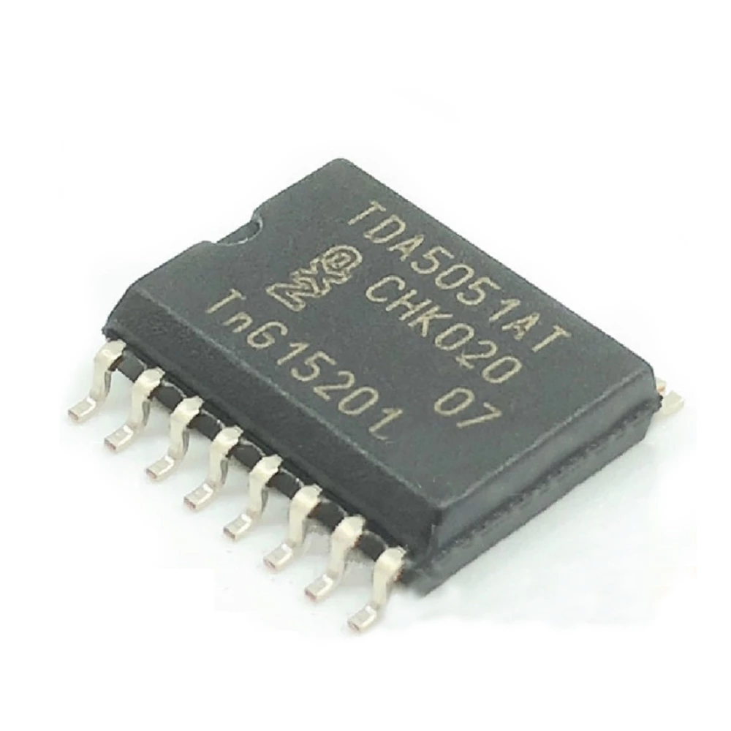
TDA5051AT POWER LINE MODEM
PLC Modem is device which is useful to send and receive serial data over the existing AC mains domestic power lines.The TDA5051A is a modem IC, specifically dedicated to ASK transmission by means of the home power It operates from a single 5 V supply.
Device features
Powered from 5V supply
Transmit and receive data from 600 baud rate up to 1200
Full digital carrier generation and shaping
Modulation/demodulation is performed inside the IC
Built-in Digital filtering and rejection of aliasing components
Requires few external components for low cost applications

Slide 20
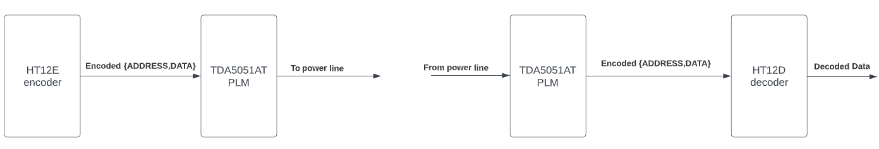
PLC Modem
The module is designed to provide simplex (one way) communication over the mains of the 220V AC and for a frequency of 50 Hz or 60 Hz
The module is divided into two sides , the transmitter side and the receiver side
A pair of decoder/encoder IC’s are used to parse the data for transmission to a specific address and to encode the transmitted data at the transmitter side , while a decoder is used at the receiver side to decode the incoming data
Fig : Application diagram of PLC modem

Slide 21
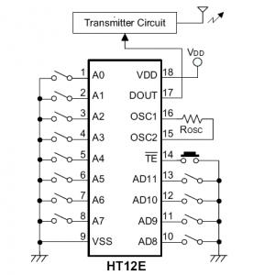
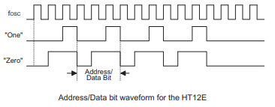
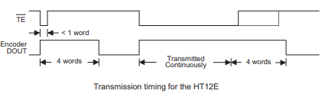
Transfer of information through the PLC modem transmitter side
In our application the user interfaces with the HT12E IC by selecting the address of the unit he wishes to communicates with using an 8 dip switch and then selecting the data he wants to send on a 4 DIP switch connected to pins AD8~AD11 .
The HT12E IC provides us with 8 bits for address and 4 bits for data .
We can connect up to 256 different receiver units .
We have up to 16 different commands.
When the TE pin is pulled low the HT12E begins transmission of a total of 13 bits to the transmitter circuit , a start bit , 8 address bits and 4 data bits .

Slide 22
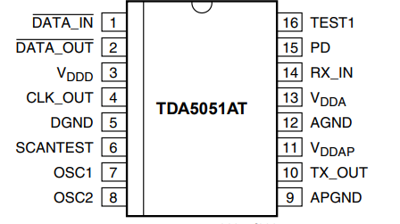
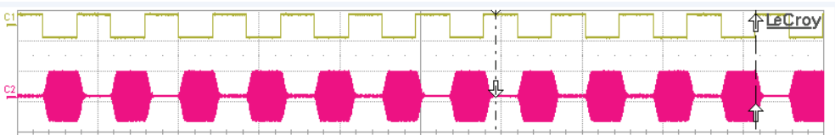
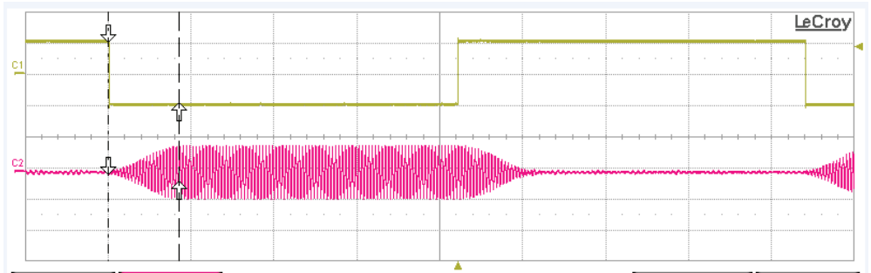
The TDA5051AT receives the incoming bitstream that is to be transmitted on its DATA_IN pin
Amplitude shift keying is then performed on the incoming bitstream , the modulated output is then generated on the TX_OUT pin to be coupled with the mains voltage
The data input (DATA_IN) is active LOW: this means that a burst is generated on the line (pin TX_OUT) when DATA_IN pin is LOW. Pin TX_OUT is in a high-impedance state as long as the device is not transmitting.
There is about 169.95 us input to output delay
TDA5051AT PINOUT
C1 DATA_IN, C2 TX_OUT

Slide 23
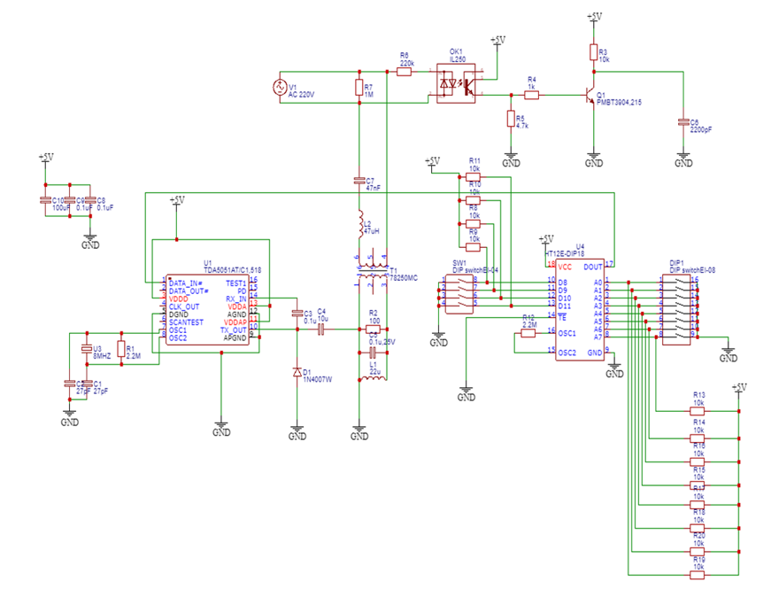
Circuit diagram of the transmitter side

Slide 24
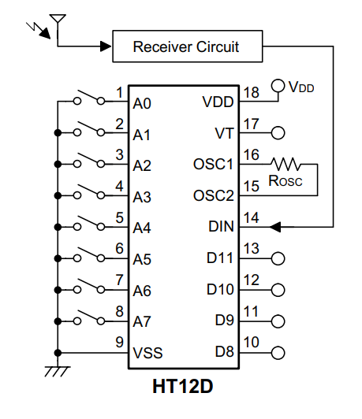
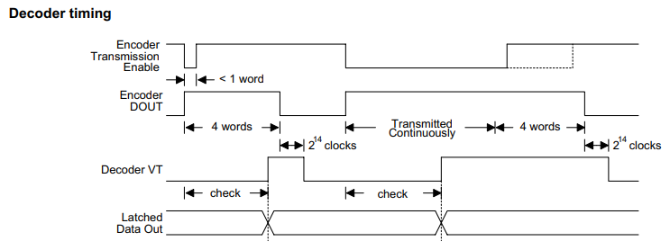
Transfer of information at the receiver side
The data is received on the RX_IN pin which is coupled to the mains voltage
The data is then filtered and demodulated on chip
The demodulated output is generated on the DATA_OUT pin , the demodulated data then needs to be decoded since it was encoded by the HT12E chip
An HT12D decoder IC is used to decode the received bitstream from the TDA5051AT
The HT12D first receives the address bits decodes them and compares the received address bits to the local address which is set by an 8 DIP switch
If the address received matches the local address the HT12D IC decodes the data bitstream and they are then latched to the output pins D8~D11
The VT (Valid transmission) pin is set HIGH when the data is received correctly

Slide 25
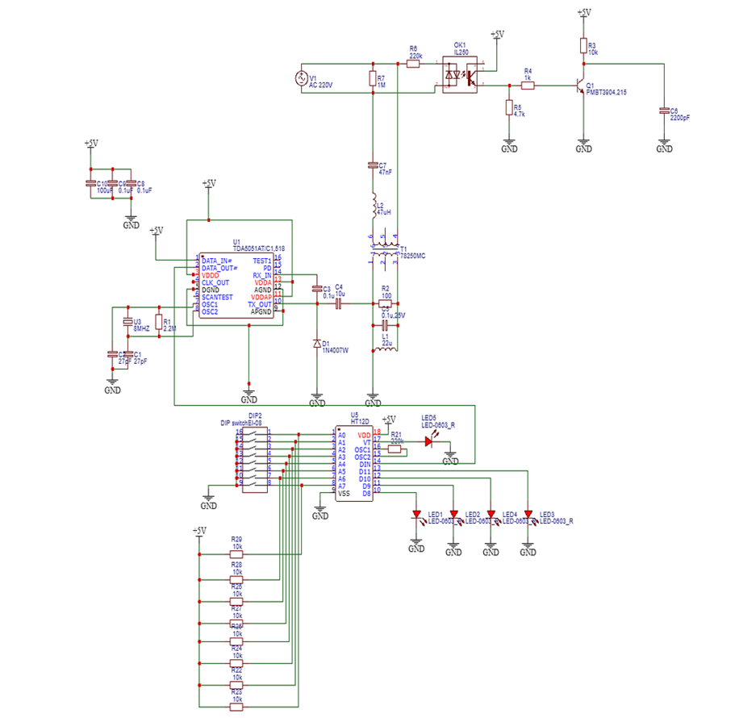
Circuit diagram of the receiver side

Slide 26
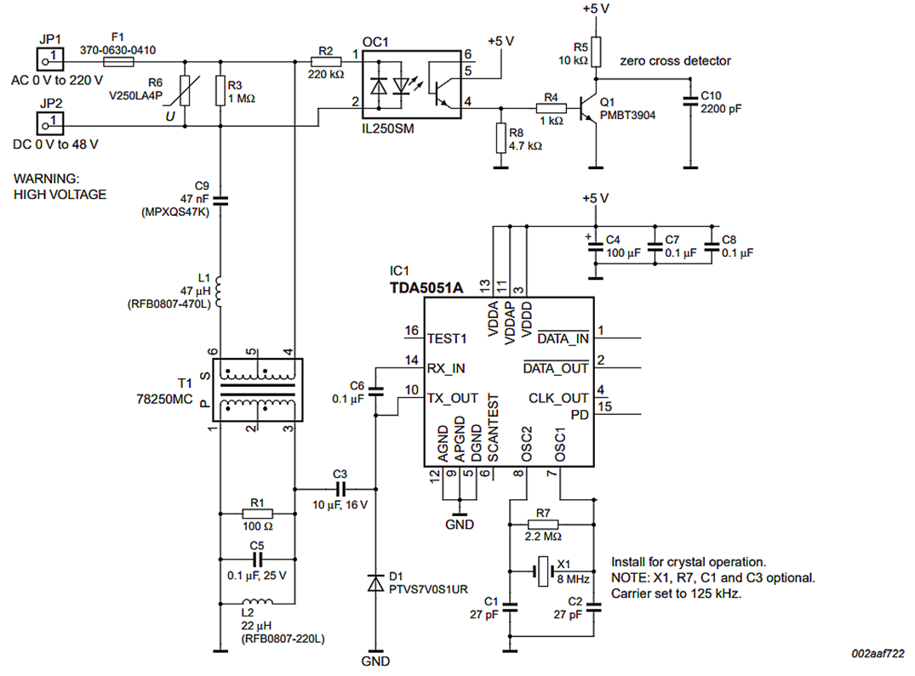
Interfacing TDA5051A with the power line
78250MC isolation transformer is used in conjunction with an LC network to couple the TX and RX pins of the TDA5051AT to the mains voltage
The isolation transformer is used to isolate the IC from the AC power source for safety reasons or to reduce transients and harmonics and to suppress electrical noise in the device
An Optocoupler IL250SM is used in conjunction with a transistor PMBT3904 to generate a zero crossing detection signal that is reserved for future use
The Optocoupler provides isolation from the mains voltage

Slide 27

Testing of the TDA5051AT circuit

Slide 28
POWER LINE MODEM WITH FEEDBACK
We can reconfigure the circuit design of the power line modem by adding a few extra components to make the power line modem a half duplex communication system instead of a simplex system.
Another pair of encoder/decoder ICs are used with a pair of inverters to generate a feedback signal from the receiver side.
The modifications are made such that only one TDA5051AT is transmitting at a time and the other is listening

Slide 29
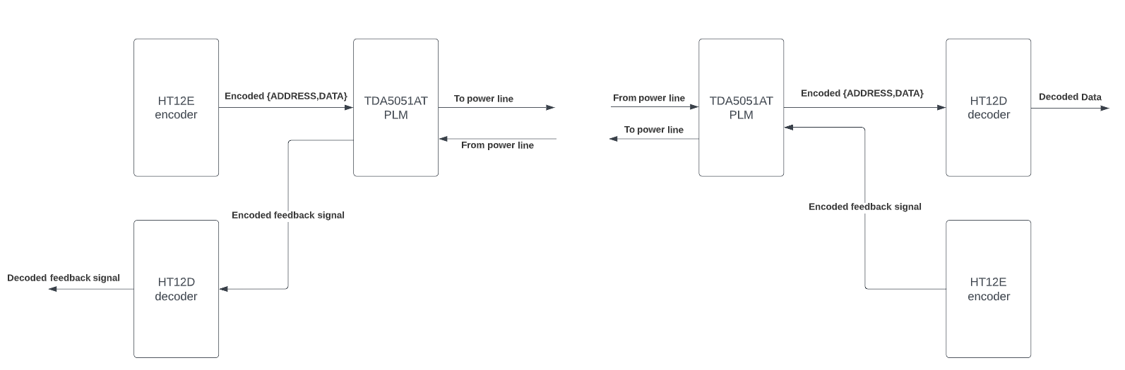
Fig shows basic block diagram of PLC module with feedback

Slide 30
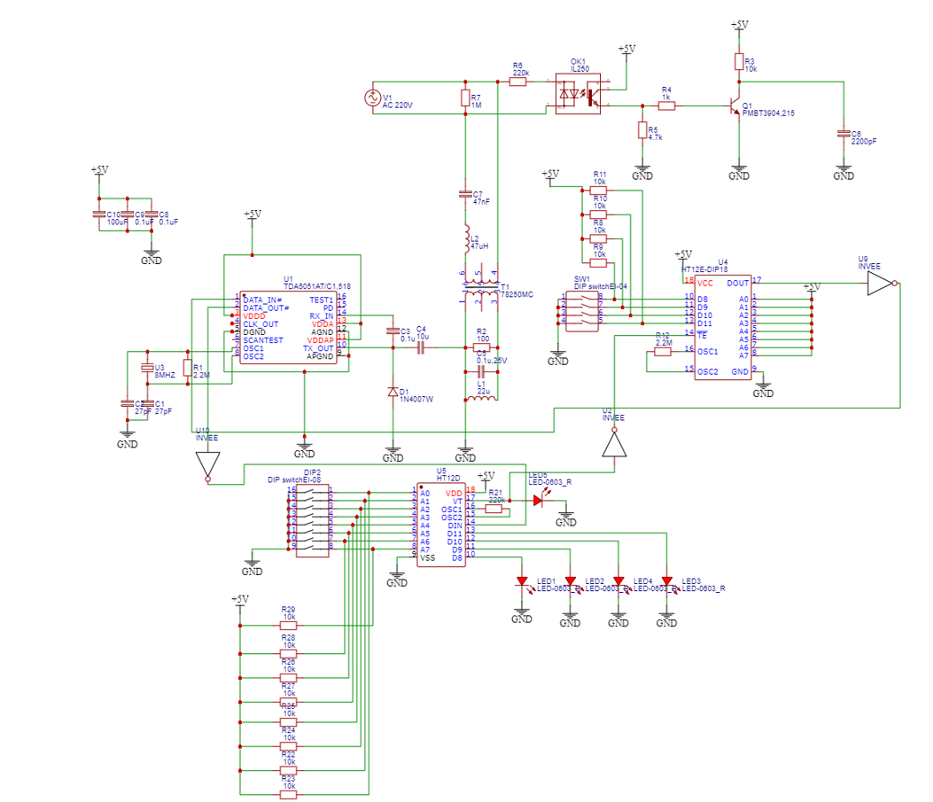
Reconfiguring receiver side to generate feedback signal
An HT12E encoder IC is installed at the receiver side to generate the feedback signal
When the transmitter sends a packet the receiver responds with this feedback signal if the packet was received correctly
After a packet is received at the receiver side the HT12D’s VT pin is set high for a short duration
This short signal can be used to automatically send a confirmation or a feedback signal back to the transmitter side
Since the HT12E’s TE(transmission enable) pin is active low an inverter is used to invert the VT output and feed it into the TE pin of the HT12E
When the receiver receives data correctly the VT pin goes high in turn causing the HT12E to start transmitting
The output pin of the HT12E is inverted and then fed into the DATA_IN pin of the TDA5051AT
Its inverted since that the default level of HT12E’s output at standby mode is set to low and in order to disable transmission at the receiver side while the transmitter is sending we have to set the DATA_IN pin high
The feedback signal could be any arbitrary bits we choose from the 4 data bits
For our purposes we choose address 0xFF and data 0x0F to represent the feedback signal

Slide 31
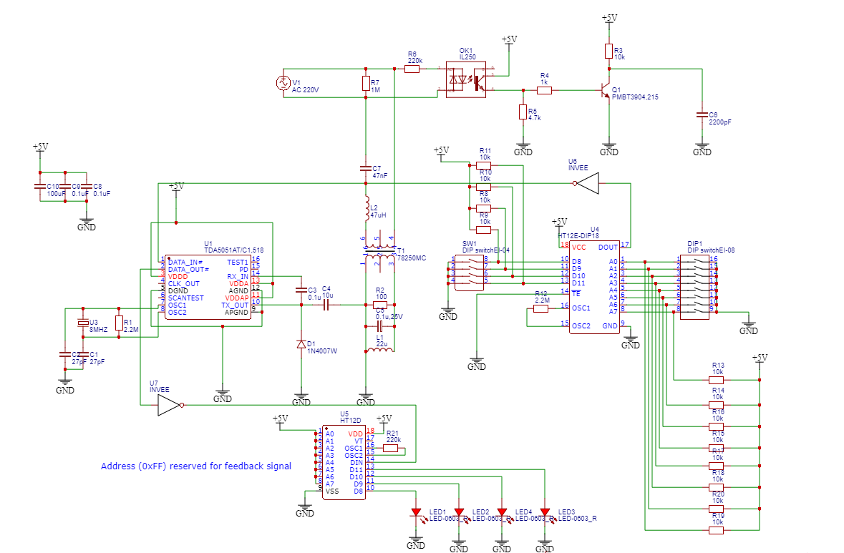
Reconfiguring transmitter side to receive feedback signal
For the transmitter side to receive a feedback signal we have to add another HT12D decoder IC to decode the incoming feedback signal
We also have to disable transmission while the feedback signal is being sent from the receiver
To disable transmission an inverter is placed between the DOUT pin of the HT12E and DATA_IN pin of the TDA5051
By doing so the DATA_IN pin is pulled high effectively disabling transmission and only enabling it when the HT12E begins transmission
We have already established that after a message is sent from the transmitter the receiver side automatically generates a feedback signal
This signal is then received at the transmitter side
But since that it was already inverted we have to invert it again to receive correct encoded feedback signal
The encoded feedback signal is then fed into an HT12D IC to decode it
If the feedback signal is received correctly the VT pin goes high and the feedback signal is displayed on LEDs at the 4 output pins of the HT12D

Slide 32
DC POWER LINE COMMUNICATIONS
The popularity of PLC adoption in smart grid applications has led to signiﬁcant focus on
PLC over AC power lines. However, narrowband PLC over DC lines is also gaining
ground in home networking, lighting and solar applications as well as in transportation
vehicles (electronic controls in airplanes, automobiles and trains). The use of PLC in
these applications reduces wiring complexity, weight, and ultimately cost of
communications

Slide 33
CONTROLLING 16x2 LCD OVER POWER LINE
16x2 LCD is too traditional and still very much popular in the world of electronics and embedded system
It requires 4 bit data lines plus additional 2 control pins, a total of 6 minimum signal pins and obviously additional 2 mandatory power wires +5v and GND, so a total of 8 wires
If this display is designed in 2019, for sure it will have only Vcc, GND and a single wire data pin or in worst case the 2 wire i2c or TWI.
Then we thought why even 1 wire for data? Because we can easily multiplex the 1 wire data line with the Vcc line by keeping a diode plus capacitor combination towards the LCD power supply pin.

Slide 34
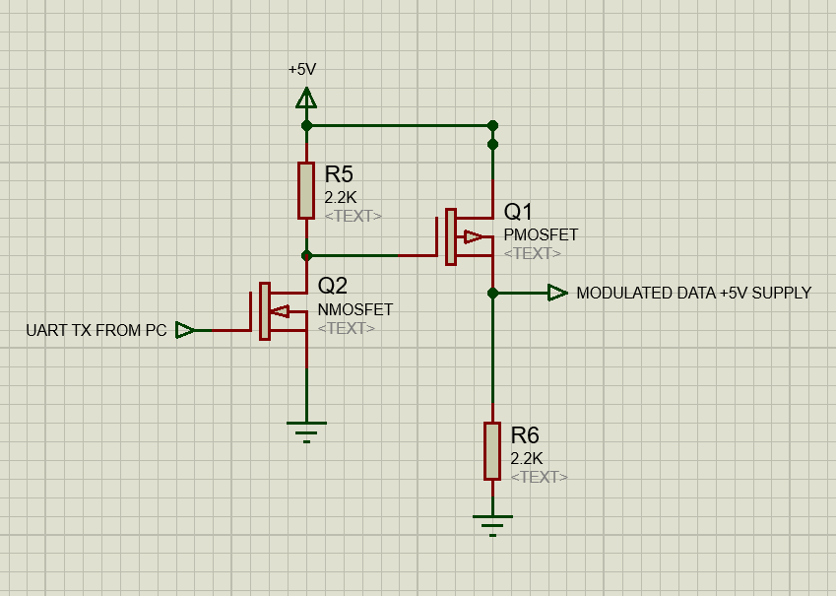
First we have a modulator that is connected to the TX pin of the UART which is transmitting data from a PC using a USB to UART converter
The modulator modulates the incoming data from the UART and superimposes it on the +5V supply line
The data we are sending from the PC are LCD initialization commands and the data to be displayed

Slide 35
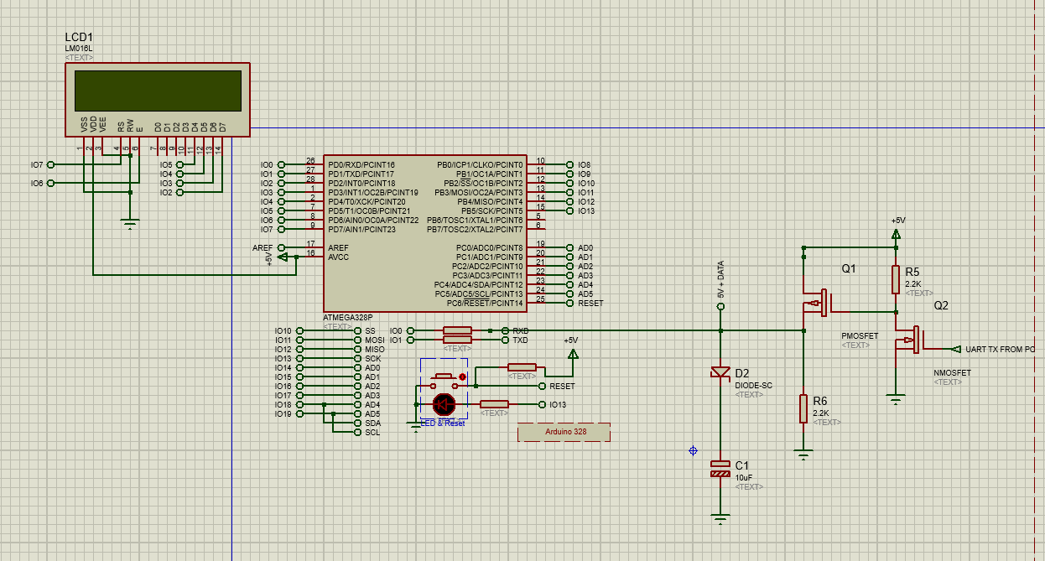
Second we have an arduino mini , its RX pin is connected to the output of the modulator
The arduino receives the incoming data on the +5V and converts the incoming serial data into parallel data to be fed to the LCD
we haven't written any LCD related initialization in the arduino,we just used it for serial to parallel conversion plus backlight LED contrast control. So the entire display initialization could be sent from current-buffered UART port
we are using a USB to UART converter to connect the device to a PC. A python script is doing the LCD initialization and data streaming over the UART

Slide 36
Default level of UART TX is high. So the left mosfet will be ON by default which turns ON the right side P-channel mosfet. This provides 5V power to the output, when uart TX sends any bytes, it starts lowering the TX pin and that will cut the 5V power and the 2.2K output resistor will pull the power rail to zero.
This zero is reﬂected to the arduino RX pin, but since there is a diode and a capacitor, the capacitor holds enough power to maintain the display circuitry to work when the power input is modulated to zero by the UART.
The role of diode is to prevent reverse discharge of the capacitor and there by allowing the diode front-end voltage to follow the UART TX by not corrupting it.
the RX pin sees the signal as pure incoming UART bytes the arduino receives the data and decodes it and then outputs that data to the LCD
a simple python script from PC side can imitate the LCD command and data along with the EN and RS control

Slide 37
Thank You

